Slide 1


Career Crafter
The Job Portal
TEAM:
PUNYAVATHI
SANTOSH

Slide 2


Agenda
Overview
Scope
Work Flow
Modules
EER Diagram
Web Api’s
Components
User-Case Diagram
Technologies
User Interface (Snapshots)

Slide 3
CareerCrafter is a comprehensive web-based platform designed to streamline job hunting and recruitment processes. It enables employers to post job listings and manage applications, while job seekers can search for jobs, apply, and manage their applications efficiently. The platform also includes a resume database feature for seamless storage and sharing of qualifications.
Overview

Slide 4
User Registration and Authentication:
Secure account creation and authentication.
Role-based access control for employers and job seekers.
Employer Module:
Create, edit, and manage job listings.
Dashboard for tracking applications, viewing candidate profiles, and managing postings.
Job Seeker Module:
Create and manage user profiles with personal, educational, and professional details.
Robust search functionality to find relevant job listings.
Apply to jobs directly, submitting resumes and required documents.
Application Management:
Track and manage job applications.
Resume Database:
Functions to update the resumes.
Scope

Slide 5
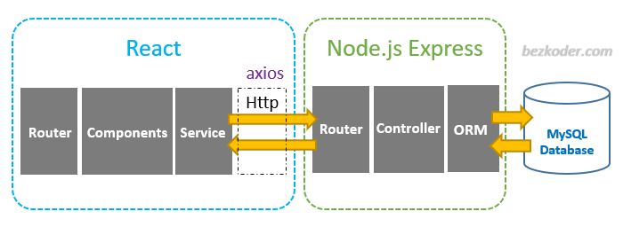
WORK FLOW

Slide 6
MODULES
EMPLOYER
MODULE
USER
MODULE

Slide 7
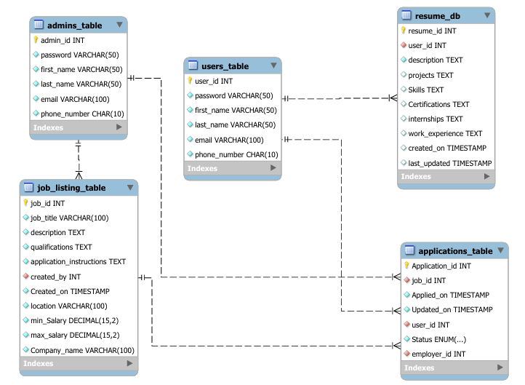
EER-DIAGRAM

Slide 8
USER WEB API’S
USER API’S
Getting jobs
Applying jobs
Getting applications
Withdrawing applications
Getting profile details
RESUME API’S
Validating before creating new user
Validating parameters before updating
Token validator
Authentication API
Login
Updating password
User registration
Updating user details

Slide 9
ADMIN WEB API’S
ADMIN API’S
Getting jobs
View jobs
Update Jobs
Delete Jobs
Post Jobs
Authentication API’s
Login
Updating password
Admin registration
Application API’S
View Applications
Update Applications Status
View User Resume

Slide 10
Components
ADMIN Component’s
Applications
Jobs
Job Forms
Admin Login
Admin Register
Common Component’s
Headers
Footers
About Us
Contact Us
Carousel
Testimonial Cards
ADMIN API’S
New User Register
Login
My Applications
Profile
Resume
Search Jobs

Slide 11
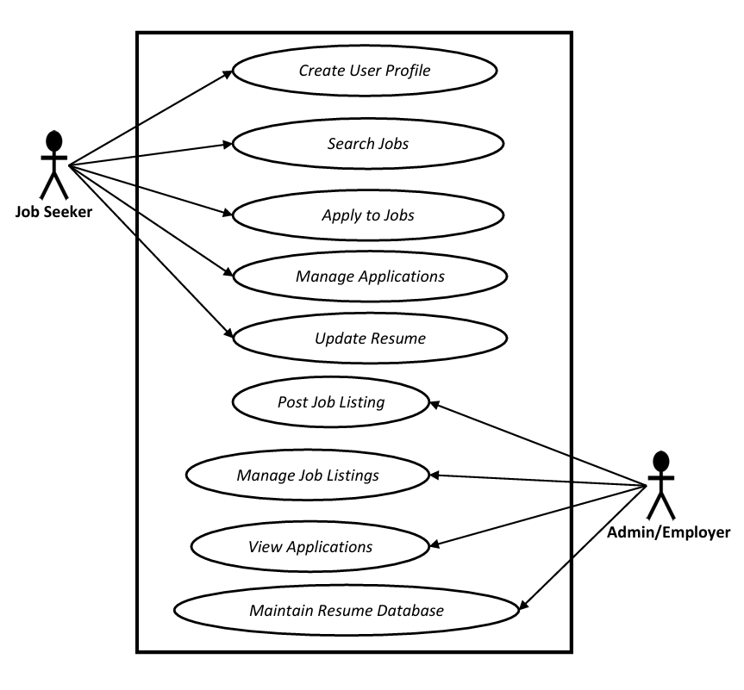
User-Case Diagram

Slide 12
Frontend: React.js
Backend: Express JS for API development
Database: MySQL
Authentication: JSON Web Tokens (JWT) for secure user authentication
Styles : Bootstrap , CSS.
Technology

Slide 13
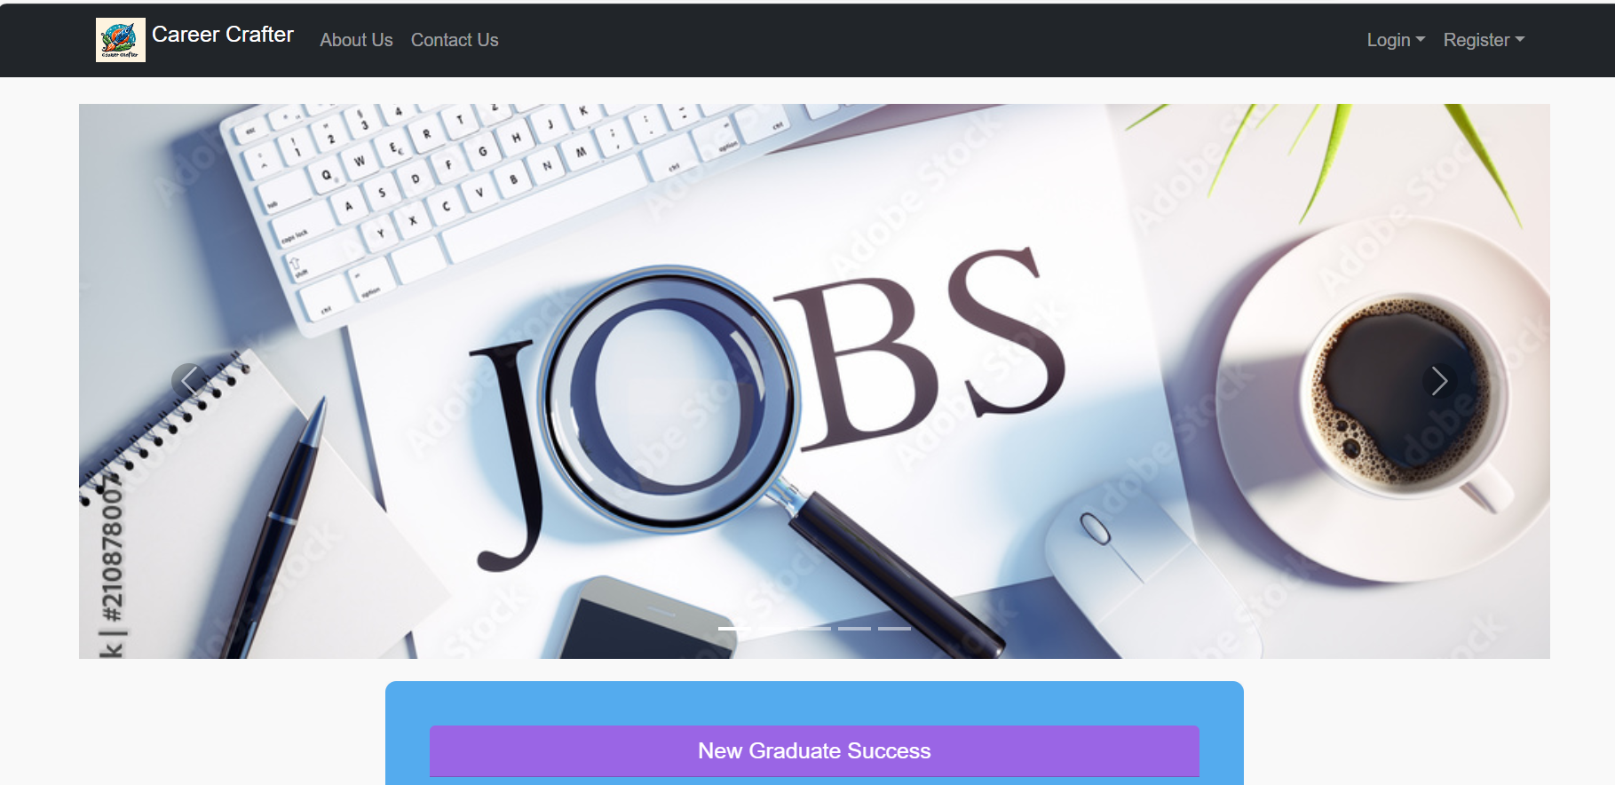
User Interface (Snapshots)

Slide 14
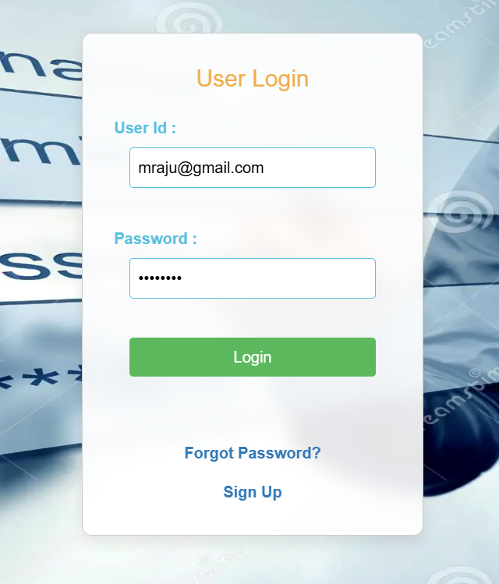
User Login Page

Slide 15
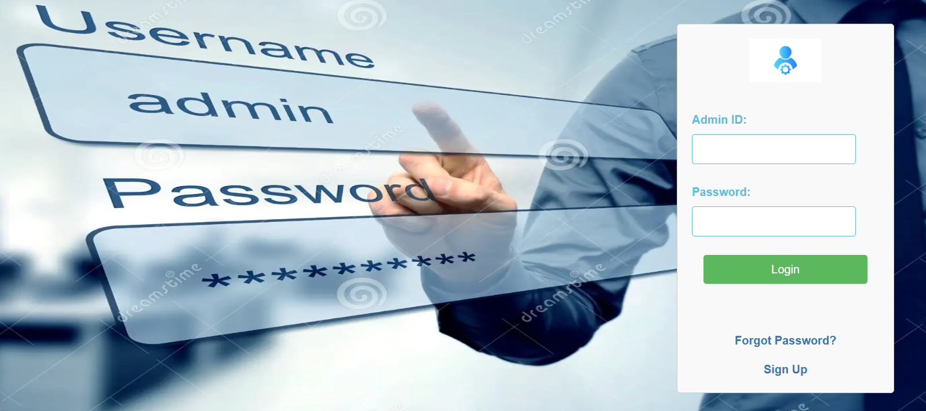
Admin Login Page

Slide 16
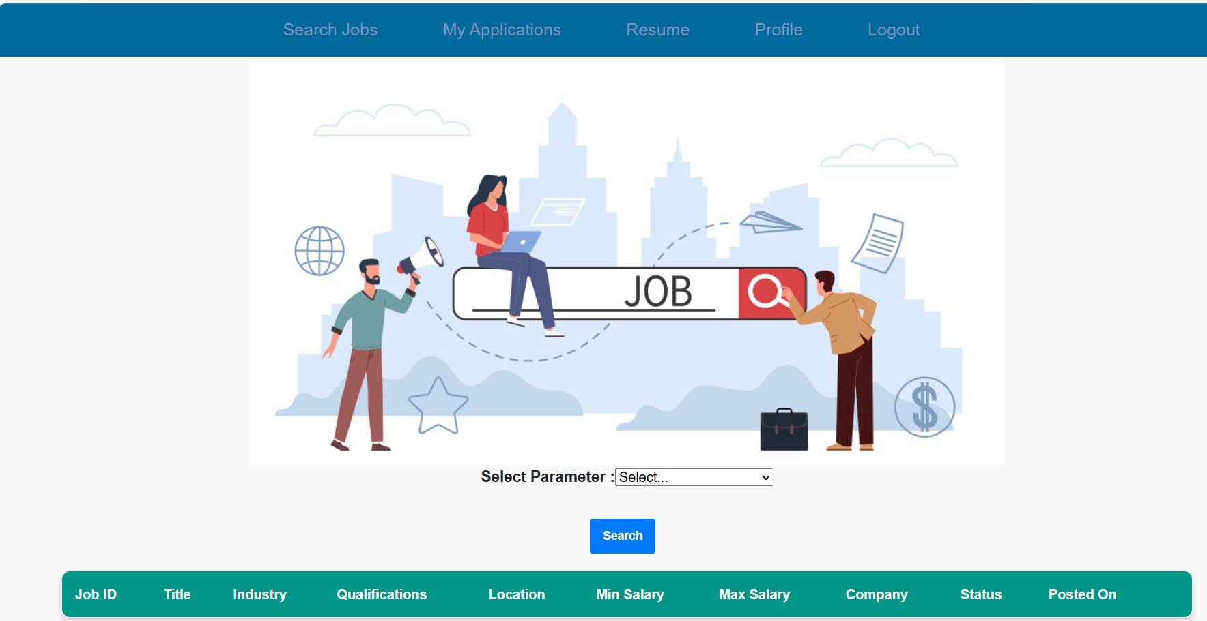
User Home Page

Slide 17
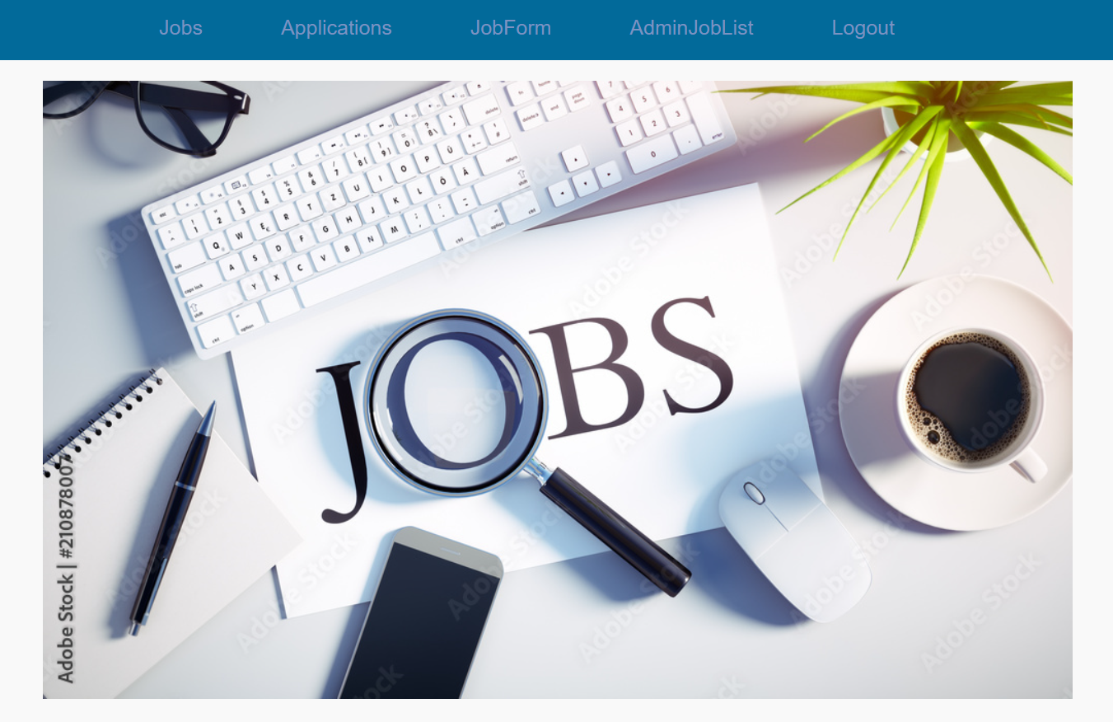
Admin Home Page

Slide 18
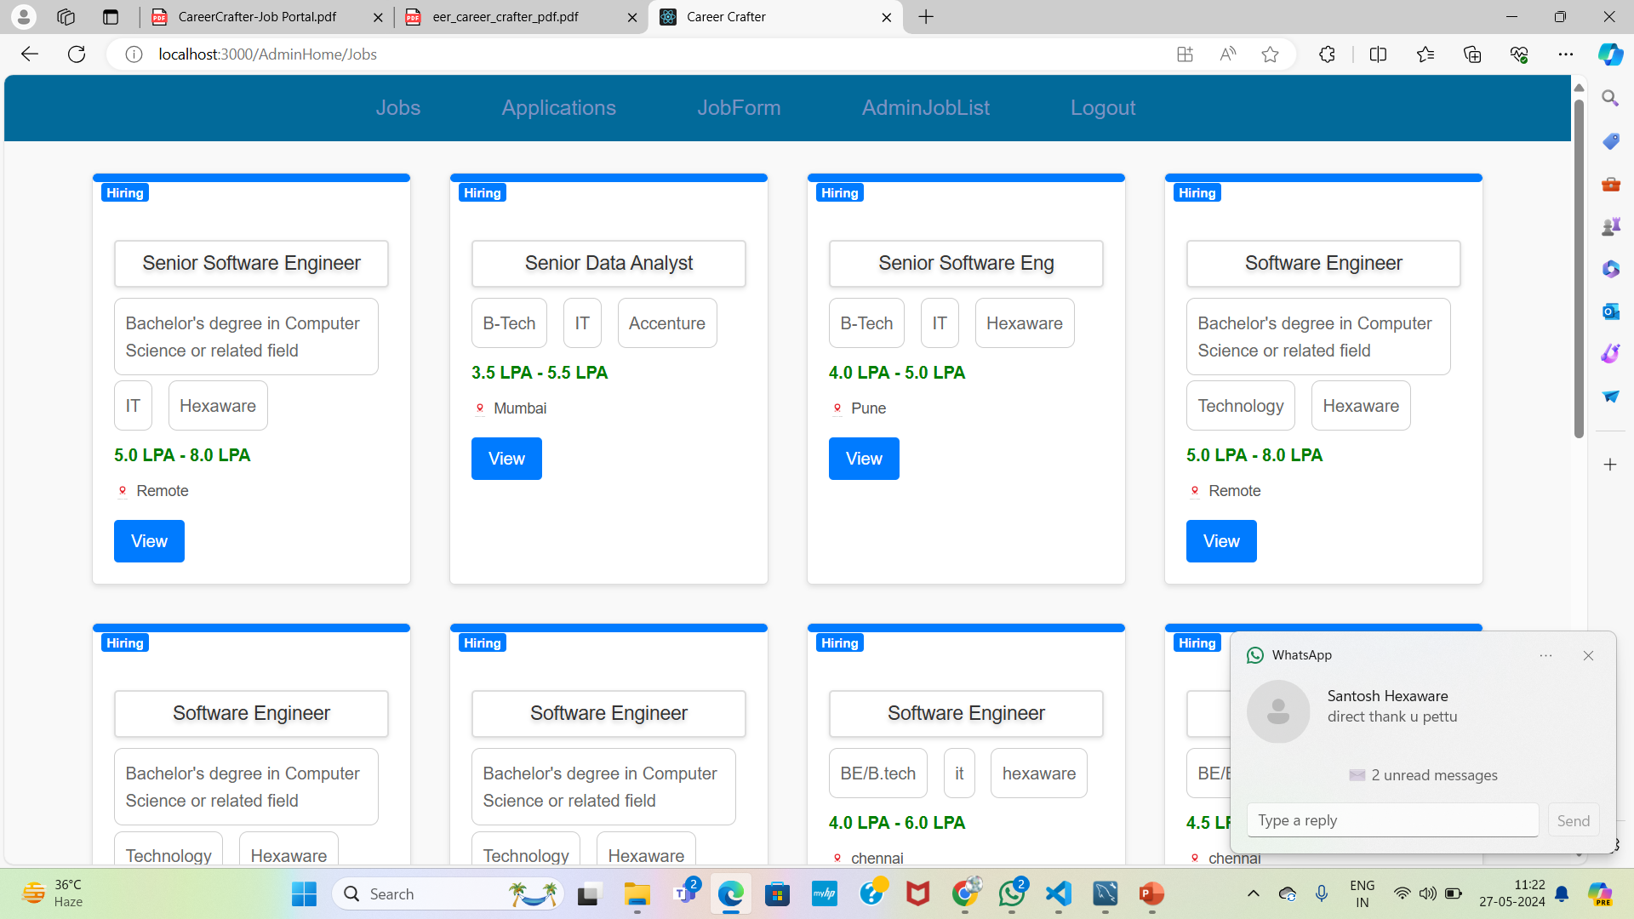
Admin Posted Jobs

Slide 19
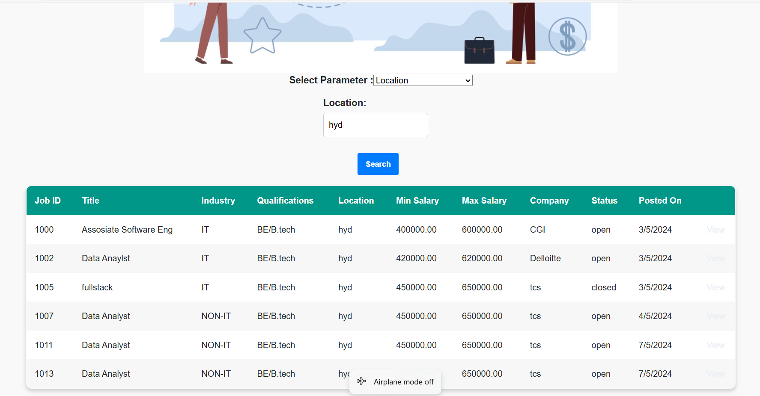
User Jobs

Slide 20


